Slide 1
Module ChE 311 Biochemical Engineering
Downstream processing
Take home messages
Simon Crelier, HES-SO Valais – Sion
simon.crelier@epfl.ch
+41 (0)27 606 86 65

Slide 2
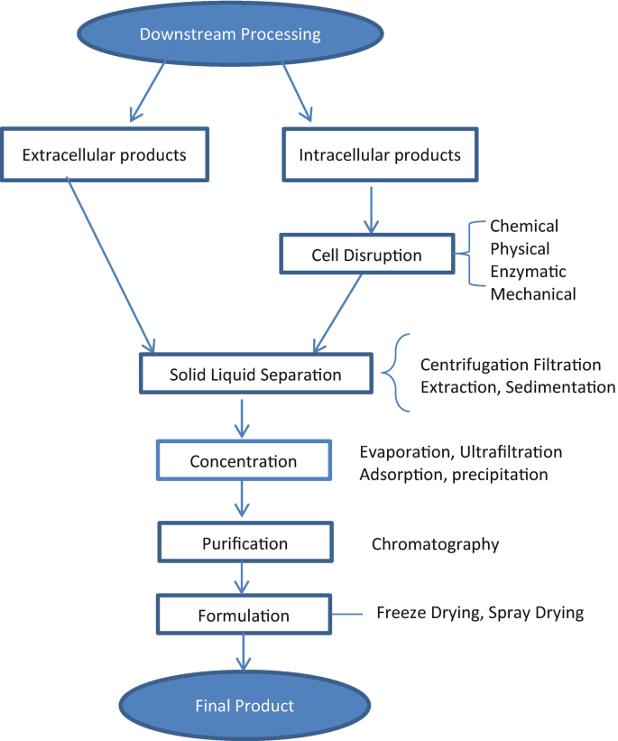
Introduction
DSP represents more than 50% of production costs
It features three main steps: Capture, purification, polishing
Product can be intracellular or extracellular (sometimes the cells themselves)
The more dilute the product, the more expensive the purification
A robust analytics is key to success; it comprises at least a generic protein dosage and a specific measurement of the target molecule(s)
There are physical and thermal (driven by thermodynamics) separation techniques
Each has 4 characteristics: Capacity, Resolution, Yield, Speed (cost is no technical element but it also influences the selection)
Few purification steps with high yields are always sought
DSP has to be discussed early in the process development
The most expensive techniques should be applied last
Purity should not be achieved to the detriment of (bio)activity
Source: A. Agarwal et al., 2020

Slide 3
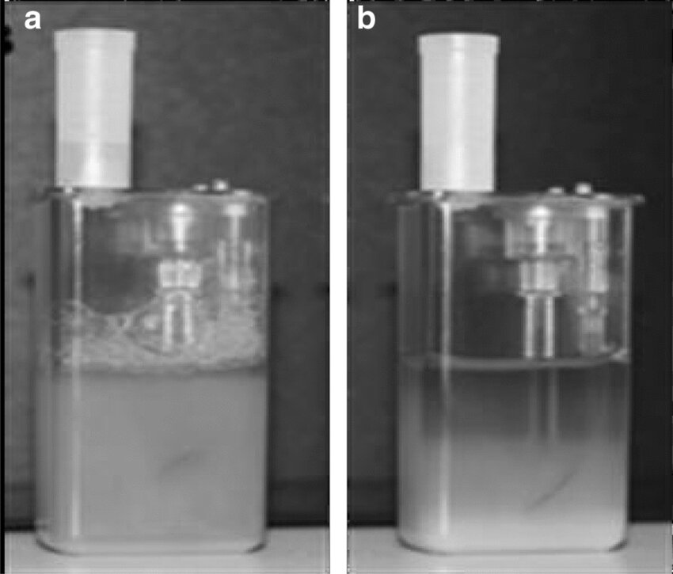
Sedimentation
Sedimentation is of little use in bioprocess DSP (bacteria and yeast cells sediment veeeeeeery slowly)
Depending on suspension properties, different flow regimes may occur (laminar, transient or turbulent, depending on the value of the Reynolds number for particles Re_{p} )
There is an equation for the terminal settling velocity v_{lim,p} adapted to each flow regime
For aqueous cell suspensions, flow is always laminar
Key equation for the dimensioning of sedimentation tanks is Q = v_{lim,p} ·A : The equation says that the capacity Q of the plant is determined by the properties of the suspension to be separated (v_{lim,p}) and the characteristics of the equipment used for separation (area A)
Source: L. Jin et al., Biotechnology Letters 43(2):1-11 (2021)

Slide 4
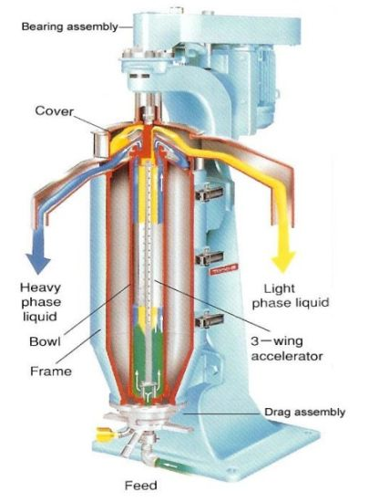
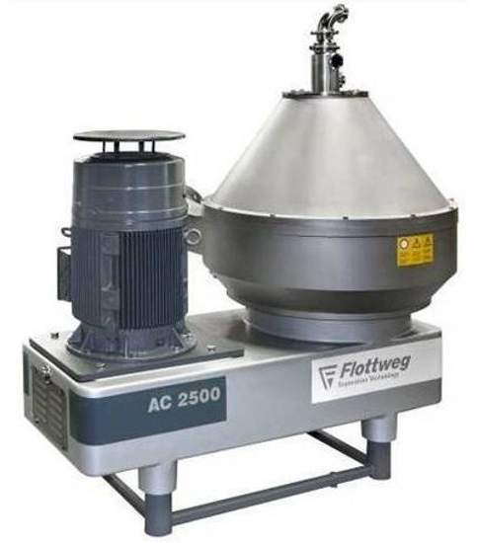
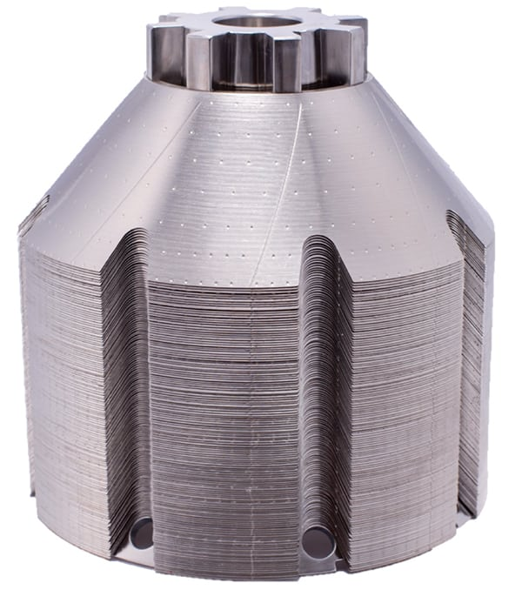
Centrifugation
Starting point: same as for sedimentation, one simply replaces g by rω² in the equation for particle velocity
Different designs and geometries for industrial centrifuges, depending on capacity,solid content, fraction to be recovered, hygienic constraints … (be ready to identify them)
Most commonly used in bioprocesses: disk stack centrifuges
For tubular bowl and disk stack centrifuges, capacity Q is calculated in a similar way to sedimentation tanks: Q = v_{lim,p} ·A = v_{lim,p} ·Σ (Sigma factor analysis)
Source: www.caledolex-nc.com
Source: www.flottweg.com
Source: www.chemengonline.com

Slide 5
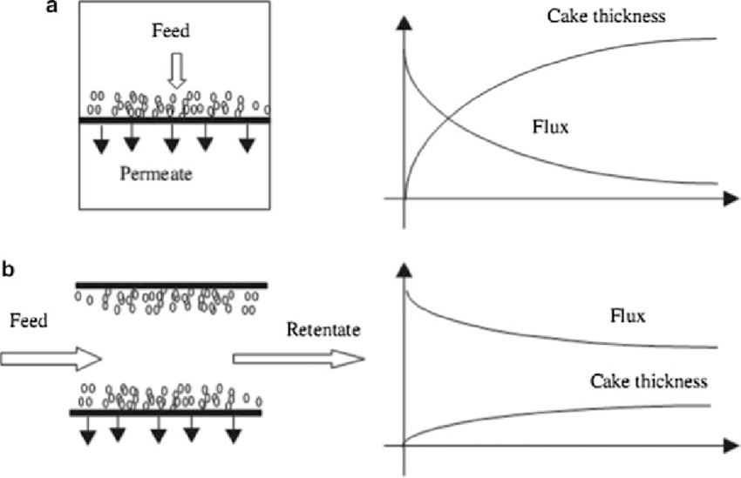
Filtration
Darcy’s law = starting point (fluid flow through porous medium)
Filtration data are very easy to collect: measurement of filtrate volume V_{f} vs time t. The curves can be linearized, giving access to useful information: Slope yields info on cake resistance, intercept on filter resistance
Filtrate flow rate ât any given moment is the derivative of curve V_{f} = f(t)
For compressible cakes, α depends on Δp; how?
α’ and s are determined from α = f(Δp) measurements
Designs and geometries of industrial filters
What are the means to accelerate a filtration?
What is the principle of tangential flow (or cross-flow) filtration?

Slide 6
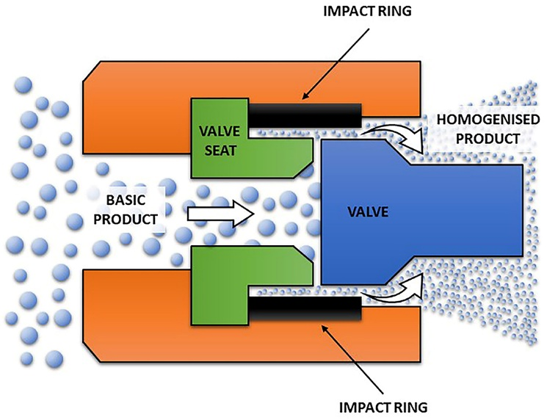
Cell lysis
There is a large selection of celly lysis techniques at lab scale
At industrial scale: only high pressure homogenization (bead mill, very seldom)
Lysis kinetics is first order in beadmill and HP homogenization. In the latter though, time t is replaced by the number of cycles N
Know how to develop the kinetics equation! (disruption progress proportional to intact fraction)
Important working parameters for these devices
Watch for simultaneous release of proteases!
Are yeasts or bacteria easier to disrupt mechanically?

Slide 7
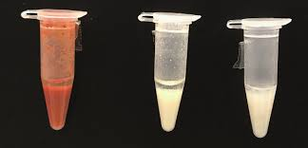
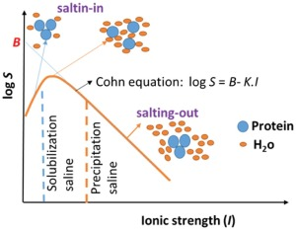
Precipitation
Precipitating agents: temperature, pH, salts, solvents, soluble polymers, polyelectrolytes
Roughly: T-induced precipitation is irreversible, pH-induced is partially reversible and electrolyte-induced is usually reversible
Cohn equation applicable to most precipitation agents: predicts exponential decrease of solubility S as a function of precipitating agent concentration C: log(S) = β - K_{s}·C
To compare results, watch out for the units that are used (log, ln, concentrations in %, mol/kg,mol/L, ionic strength)
Precipitation’s low selectivity can be improved by using affinity precipitating agents
Recovery of precipitates easier after maturation step

Slide 8
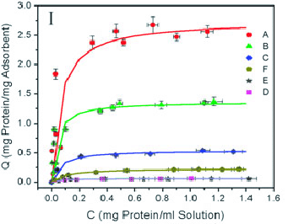
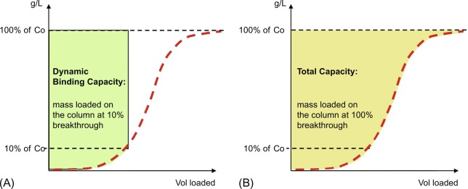
Adsorption
Surface phenomenon, equilibrated, starting point of all adsorptive chromatographies
Equilibrium line = isotherm (linear, Langmuir, Freundlich)
Favorable, linear, irreversible and unfavourable isotherms
Problems can be solved mathematically or graphically
Kinetics: mostly empirical models (pseudo 1st or 2nd order), but can also be treated rigorously (mass transfer and diffusion coefficients)
Fixed bed adsorption: mass transfer zone (MTZ), breakthrough curves, static and dynamic adsorption capacities
Empirical models for breakthrough curves (Bohart Adams, Thomas)

Slide 9
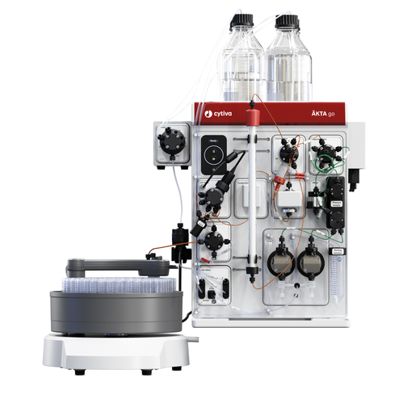
Chromatography … well, preparative chromatography !!!
Principle of bind/elute vs isocratic elution chromatography
Components of a chromatography equipment
Analytics & detection: generic and specific measurements
Properties of chromatograms & peaks: retention times, resolution, number of plates, HETP, peak symmetry
The van Deemter equation (parameters A, B, C): influence of chromatography particle size, molecule size, optimal liquid velocity/flow rate
Size Exclusion, Ion Exchange (anion, cation), Hydrophobic Interaction, Reverse Phase, Affinity chromatography
Scale-up of chromatography achieved by enlarging column diameter

Slide 10
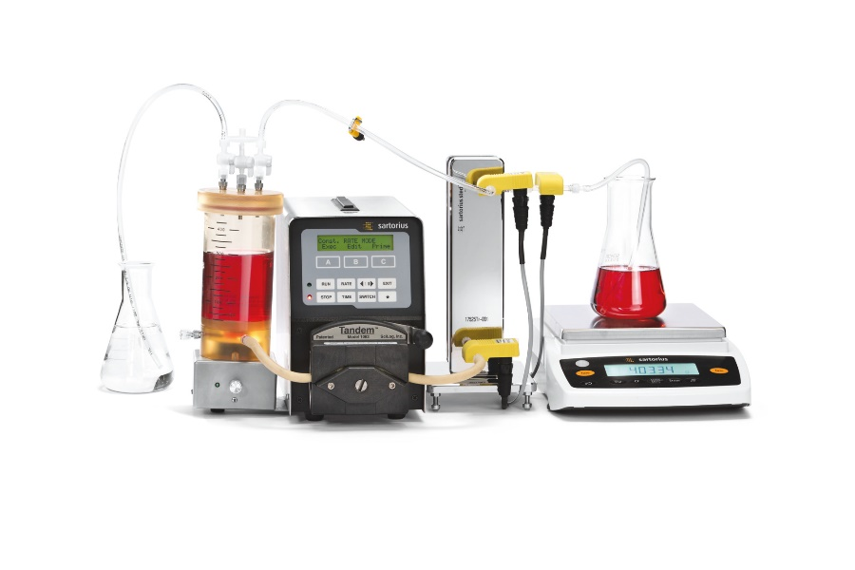
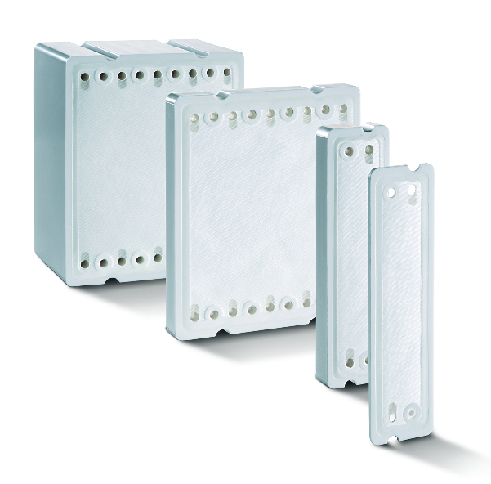
Membrane Techniques
This section was not discussed in class and will not be examined in 2025
Micro-, Ultra-, Nanofiltration, reverse osmosis
All based on the principle of CFF / TFF
Whatever the technique, you have to fight against the osmotic pressure caused by the retained species
Membrane materials for biotech media: polyether sulfone (PES) or cellulose derivatives
Can be used for concentration, fractionation or diafiltration (buffer exchange) purposes
Permeate flux is commonly expressed in LMH (L m⁻² h⁻¹)
Characterization: permeate flux as a function of TMP
Importance of the retention factor and its connexion to the NMWC
Calculation of yield and/or time course of concentration or diafiltration steps

